Slide 1

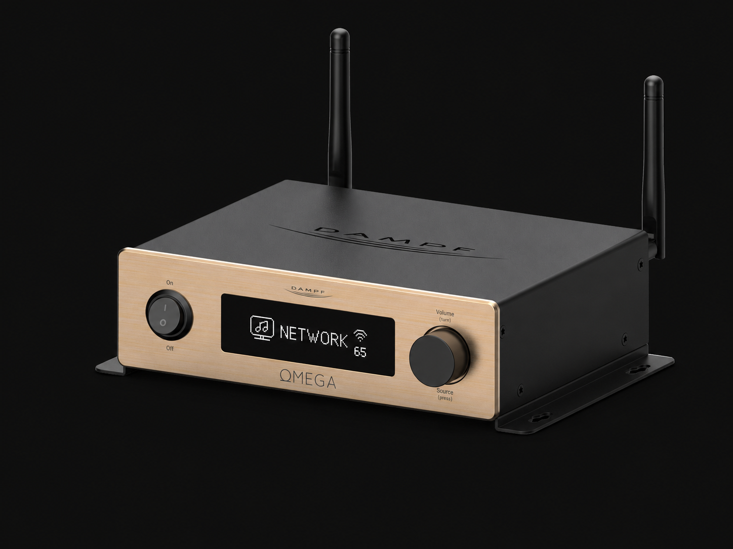

Commercial Positioning
Competitor analysis • Distributor value • Applications • Value proposition
1 product, 3 deployment modes
Standalone · Distributed · Integrated
Prepared for: NID – 07-2026
01
Dampf · OMEGA commercial deck
dampf-hotel.com

Slide 2
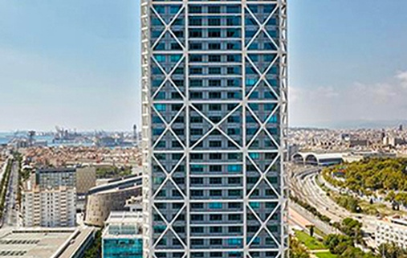

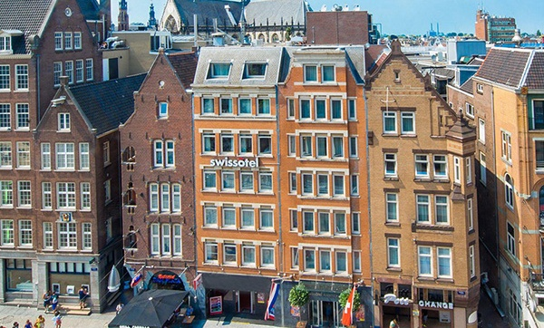
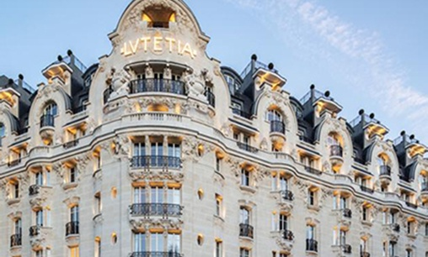


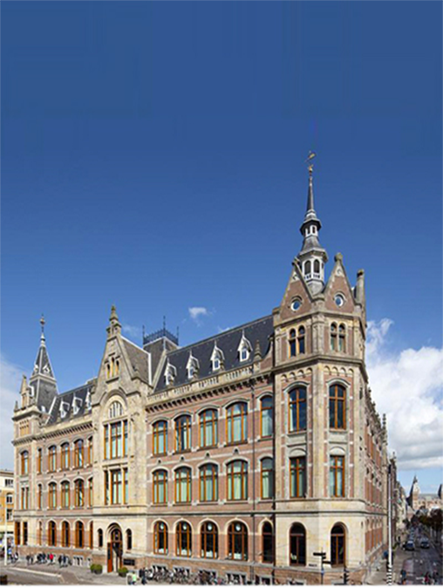
Some of our references
COMMERCIAL POSITIONING
Selected hospitality references
Hotel Arts Barcelona
Morpheus COD - Macau
Swissotel Amsterdam
Lutetia Paris
5 star
5 stars
4 stars
5 stars
Wythe - New York
Hotel Cafe Royal – London
Conservatory by Mandarin Oriental
– Amsterdam
4 stars
5 stars
5 stars
02
Dampf · OMEGA commercial deck
dampf-hotel.com

Slide 3
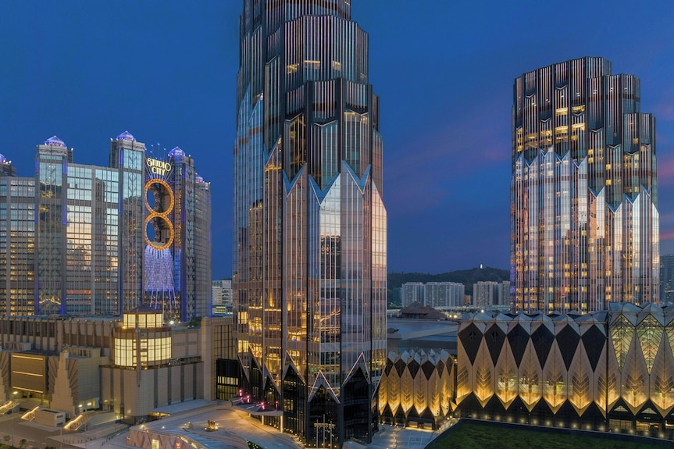

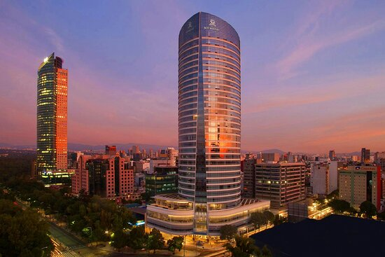

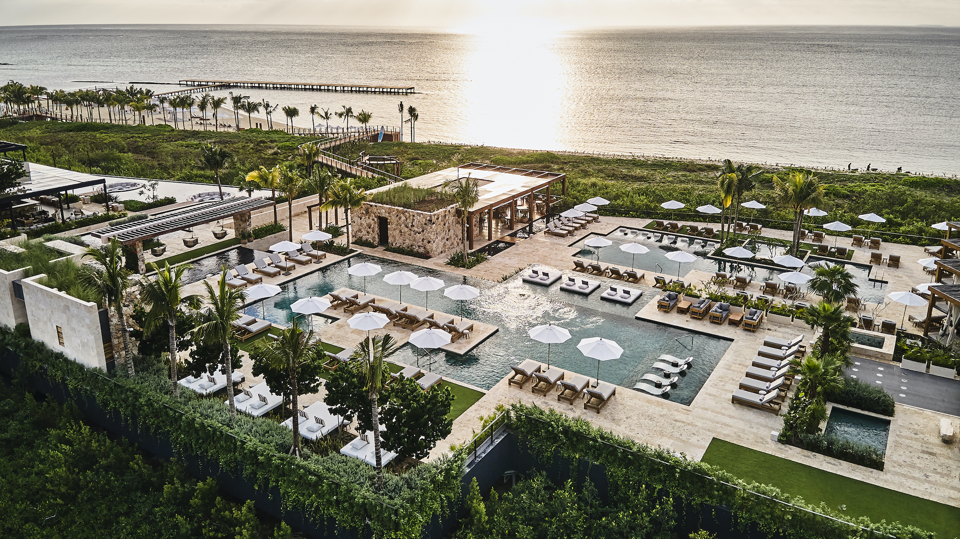
Some of our references
COMMERCIAL POSITIONING
Selected hospitality references
W Macau
NUWA COD - Macau
St. Regis Mexico city
5 star
5 stars
5 stars
The View of Rotterdam - Netherlands
Etéreo Riviera Maya by Auberge Resorts - Mexico
5 stars
5 stars
03
Dampf · OMEGA commercial deck
dampf-hotel.com

Slide 4
Premium hospitality amplifier
COMMERCIAL POSITIONING
A compact room-level platform for hospitality audio
Premium hospitality amplifier
04
Dampf · OMEGA commercial deck
dampf-hotel.com

Slide 5

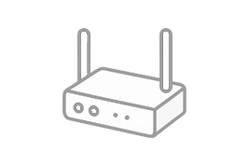

1 product, 3 deployment modes
COMMERCIAL POSITIONING
Standalone audio · streamer / receiver · integrated or multi-zone
Standalone audio
Streamer / receiver
Integrated or multi-zone
Room or suite setup: TV audio, guest streaming and passive speakers.
Use Omega as a streaming amplifier or preamp through RCA line-out.
Controlled from AV, IPTV, GRMS or grouped across rooms and zones.
1 product, 3 deployment modes
05
Dampf · OMEGA commercial deck
dampf-hotel.com

Slide 6
Omega in one sentence
COMMERCIAL POSITIONING
Omega commercial deck
Omega is a compact hospitality audio building block that combines TV audio, guest music, network streaming, amplification and third-party control in one project-friendly product.
HOTEL ROOMS
SUITES
SMALL PUBLIC AREAS
INTEGRATION
ROLL-OUTS
06
Dampf · OMEGA commercial deck
dampf-hotel.com

Slide 7
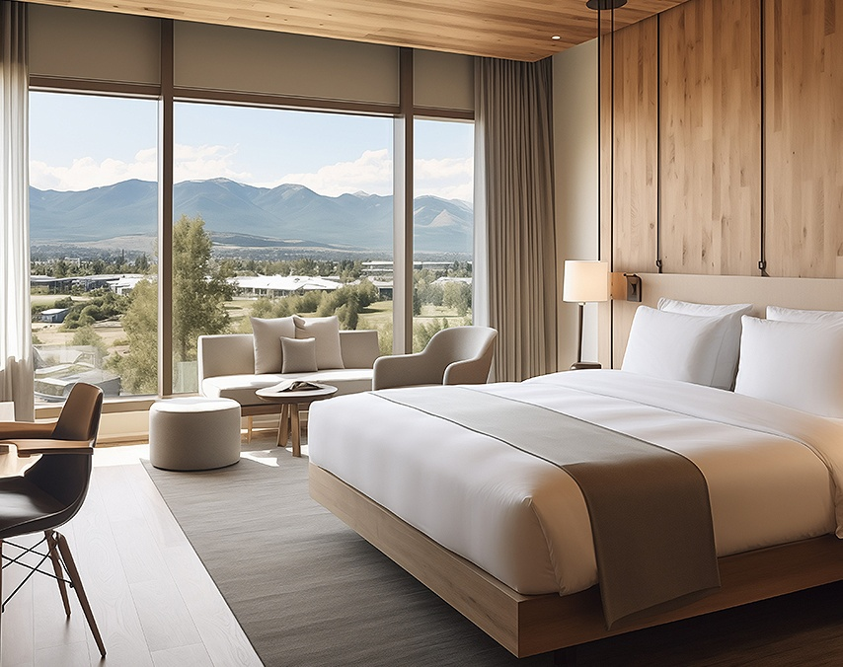


Premium hospitality amplifier
COMMERCIAL POSITIONING
Primary application areas
Hotel rooms & suites
Small to medium public areas
Residential & luxury rentals
07
Dampf · OMEGA commercial deck
dampf-hotel.com

Slide 8
Primary applications
COMMERCIAL POSITIONING
Use-case language for distributor sales
Hotel rooms
Suites & villas
Serviced apartments
Better TV sound, guest Bluetooth, streaming, volume control and hidden installation.
More premium audio experience with sub-out and line-out options for larger speaker layouts. End-user multi-room app released end of July.
Simple guest music + TV audio with professional configuration and repeatable deployment. End-user multi-room app released end of July.
Meeting rooms
Small public areas
Streamer / preamp
Compact amplifier for display audio, laptop audio (DAC), Bluetooth and simple control. Multiple Omegas can be linked.
Lounges, gyms, wellness, retail corners, show rooms and small F&B areas where a large rack is not required.
Use line-out to add Spotify Connect, AirPlay, DLNA and Bluetooth to larger amplifier setups.
08
Dampf · OMEGA commercial deck
dampf-hotel.com

Slide 9
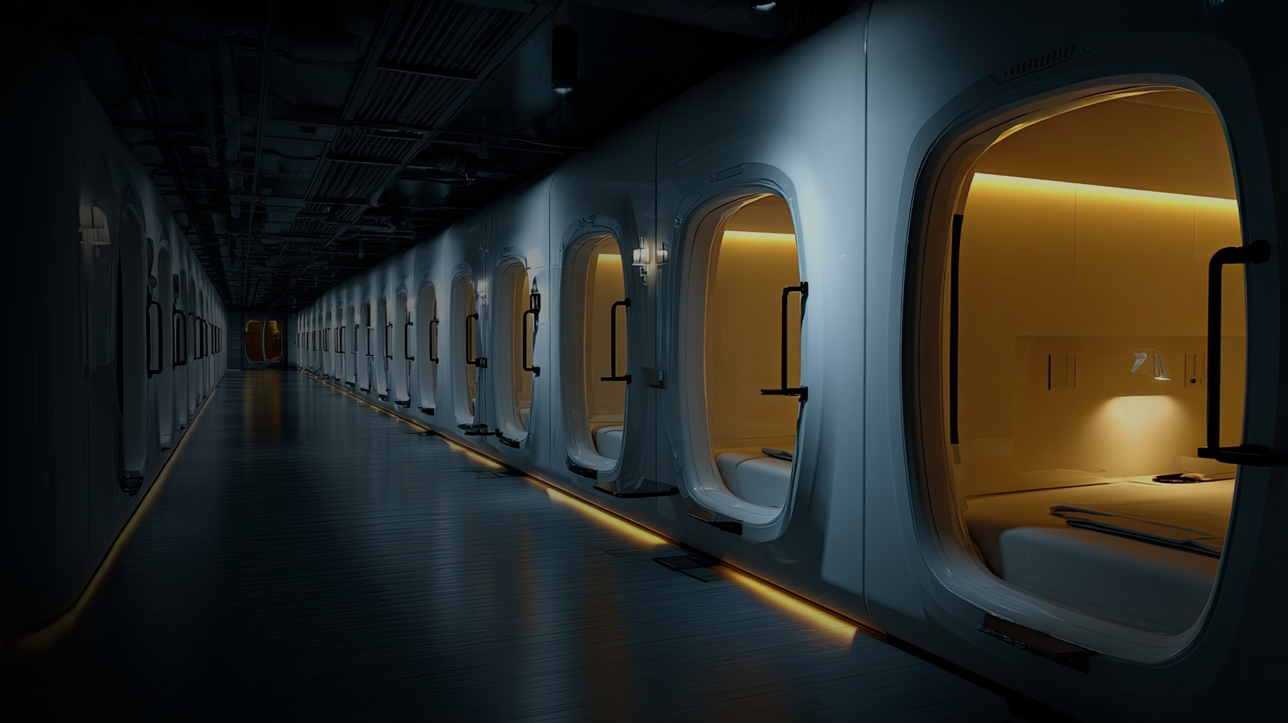
Highlighted case study
Kepler Airport Pods
Omega as an app-controlled audio endpoint inside the pod experience
Scenario
Kepler integrated Omega directly into their own sleeping-pod app. When a guest enters the pod, the app can trigger welcome / background music through Omega.
Guest enters pod → welcome music → app control → Bluetooth personal music
Guest control: turn background music off in the Kepler app, or switch to Bluetooth and play their own music.
Integration method: Kepler controls Omega with HTTP commands, so the audio behaviour follows the pod-management logic.
Roll-out logic: the same approach can be repeated in pods, villas, hotel rooms and compact hospitality formats.
Commercial takeaway
Omega becomes part of the guest journey — not just an amplifier.
Current deployment: Malaysia airport · Istanbul airport · more locations expected

Slide 10
Value proposition
COMMERCIAL POSITIONING
Why Omega is different
Why Omega is different
For the hotel
For the integrator
Better guest audio without turning the room into a consumer-app ecosystem.
A controllable component that adds technical value and commissioning work.
One affordable product for several room-level audio needs
Project-friendly price for repeatable roll-outs
Works with the distributor’s own speaker portfolio
Integration paths for AV, IPTV, automation and room control
Bridge between consumer streaming and pro-audio installations
For the distributor
For the consultant
A portfolio gap-filler that can create project volume and increase speaker sales.
A clean room-level solution where TV audio, streaming and integration are covered.
09
Dampf · OMEGA commercial deck
dampf-hotel.com

Slide 11
Omega’s competitive strength
COMMERCIAL POSITIONING
Residential simplicity + professional control for hospitality and luxury villa projects
Do not position Omega as a “better Sonos” or a more mature BluOS ecosystem. Position it as a configurable room-audio building block.
Hospitality / Villa Operation
Integration-Ready Control
Project Flexibility & Cost
Bluetooth name, PIN and pairing reset
Input enable / disable and source behaviour
Volume limits, EQ and hidden installation
Simple use for owner, guest or rental user
HTTP, TCP/IP, RS232 / UART and IR
DLNA / UPnP and player-status feedback
Controlled from IPTV, GRMS or automation
Own interface instead of consumer app dependency
HDMI ARC, Optical, RCA, USB-C, BT, streaming
Speaker out, sub out and RCA line-out
Amplifier, streamer / preamp or audio endpoint
€499 MSRP supports repeatable roll-outs
Value proposition: Omega bridges consumer streaming and professional integration — easy for the user, configurable and controllable for the installer.
10
Dampf · OMEGA commercial deck
dampf-hotel.com

Slide 12
Consumer streaming vs commercial audio
COMMERCIAL POSITIONING
Omega fills the room-level integration gap
Consumer streaming
Omega position
Traditional commercial audio
Sonos / Bluesound
Room-level integration amplifier
Rack systems / 70V / DSP
Strong app, strong brand and residential pull. Less ideal for controlled guest operation and project-specific integration.
TV + guest music + streaming + amplifier + control, with freedom to use the distributor’s own speakers and wider AV solution.
Strong for central public-area audio. Often too large or too system-heavy for individual rooms and compact roll-outs.
Omega brings modern streaming convenience into hospitality and commercial projects without the limitations of a closed consumer ecosystem or the complexity of a traditional centralized system.
11
Dampf · OMEGA commercial deck
dampf-hotel.com

Slide 13
Positioning against Sonos and Bluesound
COMMERCIAL POSITIONING
Message for the market: Omega leads with hospitality fit, open integration, flexible I/O and roll-out economics.
OMEGA
SONOS AMP
BLUESOUND POWERNODE
BLUESOUND PRO B170S
Primary position
Hospitality / integration
Residential installed audio
Premium residential streaming
Commercial background music
Amplifier
2 × 50 W @ 4/8 Ω
2 × 125 W @ 8 Ω
2 × 100 W @ 8 Ω
2 × 80 W @ 4/8 Ω; 70/100 V
TV connection
HDMI ARC + optical
HDMI ARC
HDMI eARC
No HDMI listed
Local sources
BT, RCA, USB-A, USB-C
RCA line-in
BT, USB-C, analogue/digital
Analogue + USB-A
Open project control
HTTP, TCP/IP, RS232/UART, IR
Partner integrations
Major control-system drivers
Major control-system drivers
Line / sub outputs
RCA line-out + sub-out
Sub-out
Sub / pre-out options
Sub-out
Strongest advantage
Flexible project building block (€499)
Brand + mature app (€799)
BluOS + premium Hi-Fi (€1199)
Commercial ecosystem + 70/100 V (€1100–1400)
Message for the market: Sonos and Bluesound lead with their ecosystem. Omega leads with hospitality fit, open integration, flexible I/O and roll-out economics.
12
Dampf · OMEGA commercial deck
dampf-hotel.com

Slide 14
Established drivers or direct project control
COMMERCIAL POSITIONING
Omega offers direct room-level control logic around the amplifier itself
Sonos / Bluesound
Omega
MATURE ECOSYSTEM ROUTE
DIRECT PROJECT LOGIC
Strong ready-made drivers for platforms such as Control4, Crestron, RTI and URC
Fast path for standard residential automation projects
Mature app and multiroom ecosystems
Less custom development for common use cases
Direct HTTP, TCP/IP, RS232/UART, IR and DLNA/UPnP control
Source, volume and playback-status feedback at amplifier level
Custom logic for TV, room control, IPTV, GRMS or villa applications
Installer-defined inputs, limits and system behaviour
Key message: Omega is valuable when the integrator wants the amplifier to follow the specific logic of the room, villa or hospitality project.
13
Dampf · OMEGA commercial deck
dampf-hotel.com

Slide 15
Why Omega is interesting for a distributor
COMMERCIAL POSITIONING
The opportunity is the project ecosystem around the amplifier
Portfolio gap
Project orders
Own solution
Between consumer streaming products and larger commercial audio systems.
Hotel rooms, suites, serviced apartments and repeatable small-zone roll-outs.
Combine Omega with the distributor’s speaker, control and installation portfolio.
Integrator value
Cross-selling
Commercial flexibility
Configuration, programming and commissioning remain professional services.
Speakers, subwoofers, cabling, control, network products and support.
Scalable project proposition where premium consumer products may be too costly or restrictive.
VALUE PROPOSITION | TV audio + streaming + amplification + integration in one compact, project-friendly platform.
14
Dampf · OMEGA commercial deck
dampf-hotel.com

Slide 16
More distributor value
COMMERCIAL POSITIONING
A scalable hospitality audio platform that creates project work, not just product margin
Portfolio gap
Project volume
Speaker pull-through
A product between consumer streaming and classic commercial audio.
Suitable for 20, 50, 100+ room deployments rather than only one-off retail sales.
Omega lets the distributor attach its own speaker brands and accessories.
Integrator value
Commercial differentiation
Solution ownership
Configuration, commissioning and integration protect the installer’s role.
Not another commodity amplifier; a project solution with a clearer story.
The distributor can build the full room solution around Omega.
15
Dampf · OMEGA commercial deck
dampf-hotel.com

Slide 17
Product positioning matrix
Where Omega has competitive advantage
Competitive edge
Open project control
Traditional commercial audio
Rack systems / 70V / DSP
Most products force a choice:
simple for the user OR controllable for the integrator.
Omega combines both:
room-level guest experience + open project control + roll-out economics.
Bluesound Pro B170S
Commercial background music
€1,100–1,450
OMEGA
Guest-friendly + open project control
€499
Bluesound POWERNODE
BluOS + premium Hi-Fi
€999–1,199
Closed ecosystem
Sonos Amp
Brand + mature app
€799
Key message
Omega is not a cheaper Sonos or a smaller commercial amplifier. It creates its own project category.
System-heavy / installer-only
Simple guest / owner experience
dampf-hotel.com
16A

Slide 18
Sales messages by audience
COMMERCIAL POSITIONING
Practical one-liners for the distributor team
Hotel operator
System integrator
“Upgrade the guest-room audio experience to the level guests expect at home: better TV sound, high-quality music playback and simple use, while the hotel keeps control of the system.”
“Use one compact component for TV sound, guest music, network streaming and external control.”
Distributor sales team
Consultant / specifier
“Position Omega where Sonos is too consumer-led and Bluesound is too ecosystem-led or expensive for the project.”
“A room-level hospitality audio building block with multiple control paths and flexible speaker choice.”
Hotel developer
“A repeatable specification that can scale from mock-up room to full-property roll-out.”
17
Dampf · OMEGA commercial deck
dampf-hotel.com

Slide 19
Expected objections and clean answers
COMMERCIAL POSITIONING
Simple responses that do not overclaim
“Sonos and Bluesound are better known.”
“Is the app as mature?”
Correct. Omega is not sold on brand pull; it is sold on project fit, integration and scalable deployment.
No. Sonos/BluOS lead in consumer software. Omega’s strength is installer control and hospitality application fit.
“Why not use a commercial amplifier?”
“Can we integrate it?”
For large public areas, sometimes yes. For room-level TV + music + streaming + control, Omega is more compact.
Yes: see manuals. Omega supports HTTP, TCP/IP, RS232/UART, UPnP/DLNA, IR and browser control.
18
Dampf · OMEGA commercial deck
dampf-hotel.com

Slide 20
How to approach the market
COMMERCIAL POSITIONING
Sell Omega through project conversations, not only as a streaming amplifier
Target channels
Best first projects
Hotel AV integrators
Hospitality consultants
IPTV / GRMS partners
Commercial audio installers
Music Content Providers
Fit-out contractors
Mock-up rooms
Refurbishments
Small luxury hotels
Serviced apartments
Suites and villas
Small retail and restaurants
Meeting-room and office upgrades
Roll-out mock-up
19
Dampf · OMEGA commercial deck
dampf-hotel.com

Slide 21
Final positioning statement
COMMERCIAL POSITIONING
The commercial story in one slide
Omega gives distributors a scalable hospitality audio platform: compact enough for rooms, flexible enough for integrators, and commercially realistic for roll-outs.
Do not only sell it as
Sell it as
A cheaper Sonos
A cheaper Bluesound
A generic streaming amplifier
A hospitality integration amplifier
A room-level audio building block
A project solution for repeatable deployments
Next step: validate the commercial story with a technical demo — multiroom, HTTP/status, DLNA and integration examples.
20
Dampf · OMEGA commercial deck
dampf-hotel.com

